Slide 1
Introduction to Data Management CSE 344
Lecture 1: Introduction
Couldn’t register? Signup on the overload list

Slide 2
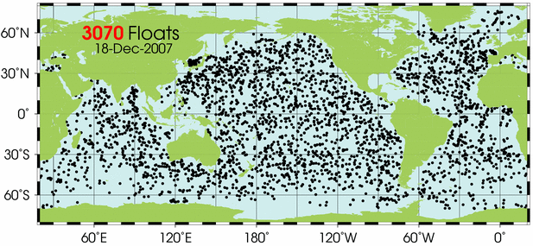


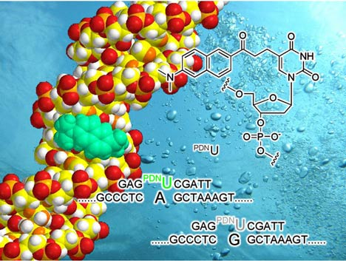
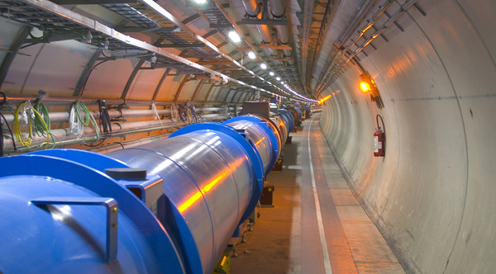
Class Goals
The world is drowning in data!
Need computer scientists to help manage this data
Help domain scientists achieve new discoveries
Help companies provide better services (e.g. Facebook)
Help governments become more efficient
This class: introduction to data management
Learn about existing tools and how to use them
Learn data management principles
CSE 444: how to build data management systems
Notes:
Give examples of how we helped astronomers with SQL Server then MapReduce.

Slide 3
Staff
Instructor: Magdalena Balazinska (aka Magda)
magda@cs.washington.edu
Office hours: Mon 10:30am-12:20pm in CSE 584
TA Matthew Moyers
mmoyers@cs.washington.edu
Office hours: Friday, 10:30-11:20am, CSE 216
TA: Vaspol Ruamviboonsuk
vaspol@cs.washington.edu
Office hours: Tuesday, 1:30-2:20pm, CSE 216
TA: Zhuohong Shen
shenz@cs.washington.edu
Office hours: Wednesday, 2:30-3:20pm, CSE 216

Slide 4
About Me: General
At UW since January 2006
PhD from MIT
Born in Poland
Grew-up in Poland, Algeria, and Canada

Slide 5
About Me: Research
Past: Stream Processing
Distributed stream processing (Borealis)
RFID data management (RFID Ecosystem)
Probabilistic event processing (Lahar)
Now: Cloud computing and Big Data mgmt
Collaboration with astronomers, oceanographers, etc.
Making large-scale data analysis easier and faster
Helping data analysts leverage the Cloud
Interactions between pricing and data management

Slide 6
Course Format
Lectures MWF, 9:30am-10:20am
Sections: Th 9:30-10:20, 10:30-11:20
Content: exercises, tutorials, questions
Location: See course website
6 Homeworks assignments
Lots of short web quizzes
Midterm and final

Slide 7
Communications
Web page: http://www.cs.washington.edu/344
Lectures will be available there (see calendar)
Homeworks will be available there
Web quizzes will be available there
Mailing list
Announcements, group discussions
You are already subscribed
Message board
Great place to ask assignment-related questions

Slide 8
Textbook
Main textbook, available at the bookstore:
Database Systems: The Complete Book, Hector Garcia-Molina, Jeffrey Ullman, Jennifer Widom
Second edition.
Most important: COME TO CLASS ! ASK QUESTIONS !

Slide 9
Other Texts
Available at the Engineering Library
(not on reserve):
Database Management Systems, Ramakrishnan
XQuery from the Experts, Katz, Ed.
Fundamentals of Database Systems, Elmasri, Navathe
Foundations of Databases, Abiteboul, Hull, Vianu
Data on the Web, Abiteboul, Buneman, Suciu

Slide 10
Grading
Homeworks 30%
Web quizzes 20%
Midterm 20%
Final 30%

Slide 11
Six Homeworks
H1 and H2: Basic SQL with SQLite
H3: Advanced SQL with SQL Server
H4: XML and XQuery with Saxon
H5: SQL in Java (JDBC)
H6: Parallel processing with MapReduce
Check course website for due dates
Notes:
Practical assignments. Look at important technologies….
Lots of new tools. This can be exhausting.
All homeworks are to be done on your own.

Slide 12
About the Homeworks
Homeworks will take a significant amount of time but most time should be spent *learning*
Very practical assignments
Put everything on your resume!!!
SQL, SQLite, SQL Server, SQL Azure JDBC, XML, XQuery, Saxon, Amazon Elastic MapReduce, Hadoop, Pig Latin, …
Notes:
This class should open up internship opportunities. All companies, big and small, have data bases and need help managing their data.

Slide 13
Many Web Quizzes
Class token on the white board: write it down
Very short online tests
Can take many times: best score counts!
Provide explanations for wrong answers
Will help you
Test your knowledge
Stay in synch with class
Get ready for homeworks
Check course website for due dates
Notes:
Say that after the deadline passes, they should be able to see the detailed explanation for each question.

Slide 14
Exams
Midterm and Final
Check course website for dates
Location: in class
Check past offerings of 344 and 444 for practice exams with solutions

Slide 15
Outline of Today’s Lecture
Overview of database management systems
Why they are helpful
What are some of their key features
What are some of their key concepts
Course content

Slide 16
Database
What is a database ?
Give examples of databases

Slide 17
Database
What is a database ?
A collection of files storing related data
Give examples of databases
Accounts database; payroll database; UW’s students database; Amazon’s products database; airline reservation database

Slide 18
Database Management System
What is a DBMS ?
Give examples of DBMSs

Slide 19
Database Management System
What is a DBMS ?
A big program written by someone else that allows us to manage efficiently a large database and allows it to persist over long periods of time
Give examples of DBMSs
Oracle, IBM (DB2, Informix), Microsoft (SQL Server, Access)
Sybase
Open source: MySQL (Sun/Oracle), PostgreSQL
Open source library: SQLite
We will focus on relational DBMSs most quarter

Slide 20
An Example: Online Bookseller
What data do we need?
Data: Information on books, customers, pending orders, order histories, trends, preferences, etc. Massive data: hundreds of GB and growing!
What capabilities on the data do we need?
Add books, find a specific book, list all books in a certain category and price range, generate an order history, produce sales figures grouped by state, etc
Data is persistent: outlives application
Data is safe: from failures, malicious users, etc
Multi-user access

Slide 21
Multi-user discussion
Jane and John both have ID number for gift certificate (credit) of $200 they got as a wedding gift
Jane @ her office orders "The Selfish Gene, R. Dawkins" ($80)
John @ his office orders "Guns and Steel, J. Diamond" ($100)
Questions:
What is the ending credit?
What if second book costs $130?
What if system crashes?
Notes:
Appears similar to concurrent programming problems (synchronization, semaphores, etc.)
BUT: data not main-memory variables
Appears similar to file system concurrent access
BUT: want to control at smaller granularity
Also database may be distributed, replicated

Slide 22
Summary Required Data Management Functionality
Describe real-world entities in terms of stored data
Persistently store large datasets
Efficiently query & update
Must handle complex questions about data
Must handle sophisticated updates
Performance matters
Change structure (e.g., add attributes)
Concurrency control: enable simultaneous updates
Crash recovery
Security and integrity

Slide 23
Discussion
Did you ever encounter a data management problem?
Experimental data from a homework?
Personal data?
Other data?
How did you manage your data?

Slide 24
DBMS Benefits
Expensive to implement all these features inside the application
DBMS provides these features (and more)
DBMS simplifies application development

Slide 25
Client/Server Architecture
There is a single server that stores the database (called DBMS or RDBMS):
Usually a beefy system, e.g. IISQLSRV1
But can be your own desktop…
… or a huge cluster running a parallel DBMS
Many clients run apps and connect to DBMS
E.g. Microsoft’s Management Studio
Or psql (for PostgreSQL)
More realistically some Java or C++ program
Clients “talk” to server using JDBC protocol

Slide 26
People
DB application developer: writes programs that query and modify data (344)
DB designer: establishes schema (344)
DB administrator: loads data, tunes system, keeps whole thing running (344, 444)
Data analyst: data mining, data integration (344, 446)
DBMS implementor: builds the DBMS (444)

Slide 27
Key Data Mngmt Concepts
Data models: how to describe real-world data
Relational, XML, graph data (RDF)
Schema v.s. data
Declarative query language
Say what you want not how to get it
Data independence
Physical independence: Can change how data is stored on disk without maintenance to applications
Logical independence: can change schema w/o affecting apps
Query optimizer and compiler
Transactions: isolation and atomicity

Slide 28
What This Course Contains
Focus: Using DBMSs
Relational Data Model
SQL, Relational Algebra, Relational Calculus, datalog
Semistructured Data Model
XML, XPath, and XQuery
Conceptual design
E/R diagrams, Views, and Database normalization
Transactions
Parallel databases, MapReduce, and Pig-Latin
Data integration and data cleaning
Notes:
For each item, say why we are learning about it.

Slide 29
Content through Homeworks
H1 and H2: Basic SQL with SQLite
H3: Advanced SQL with SQL Server
H4: XML and XQuery with Saxon
H5: SQL in Java (JDBC)
H6: Parallel processing with MapReduce

Slide 30
What to Do Now
http://www.cs.washington.edu/344
Homework 1 will be posted at 5pm today!
Simple queries in SQL Lite
Homework due next Monday
Webquiz 1 is open!
Create account at http://newgradiance.com/
Use course token
Webquiz due next Monday also!
Notes:
Actually, all web quizzes are open on day 1.

